Slide 1
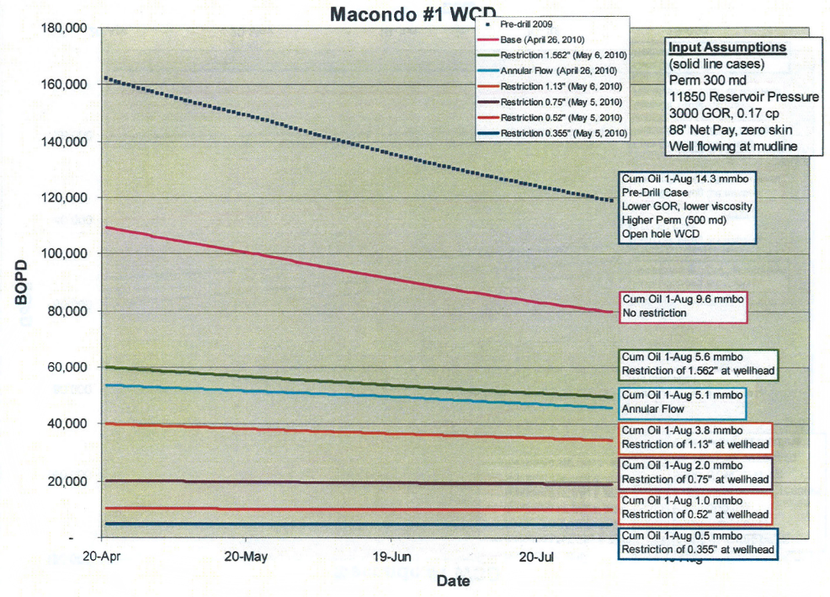
Internal vs. External Flow Rate Estimates
BP Internal Flow Rate Estimates
Reported to Coast Guard
“edit freely.”
[Source: TREX-9155, 9157, 9330, 11906] D25011A

Slide 2
Internal vs. External Flow Rate Estimates
BP Internal Flow Rate Estimates
Reported to Coast Guard
“edit freely.”
55,000
5,000
[Source: TREX-9155, 9157, 9330, 11906] D25011A

Slide 3
Internal vs. External Flow Rate Estimates
BP Internal Flow Rate Estimates
Reported to Coast Guard
55,000
5,000
[Source: TREX-9155, 9157, 9330, 11906] D25011A

Slide 4
Internal vs. External Flow Rate Estimates
Reported to Coast Guard
55,000
5,000
[Source: TREX-9155, 9157, 9330, 11906] D25011A

